Slide 1
Close that Loop! Re-Claiming Churned App Customers
Feedback
Ignored
Connor Fordham

Slide 2
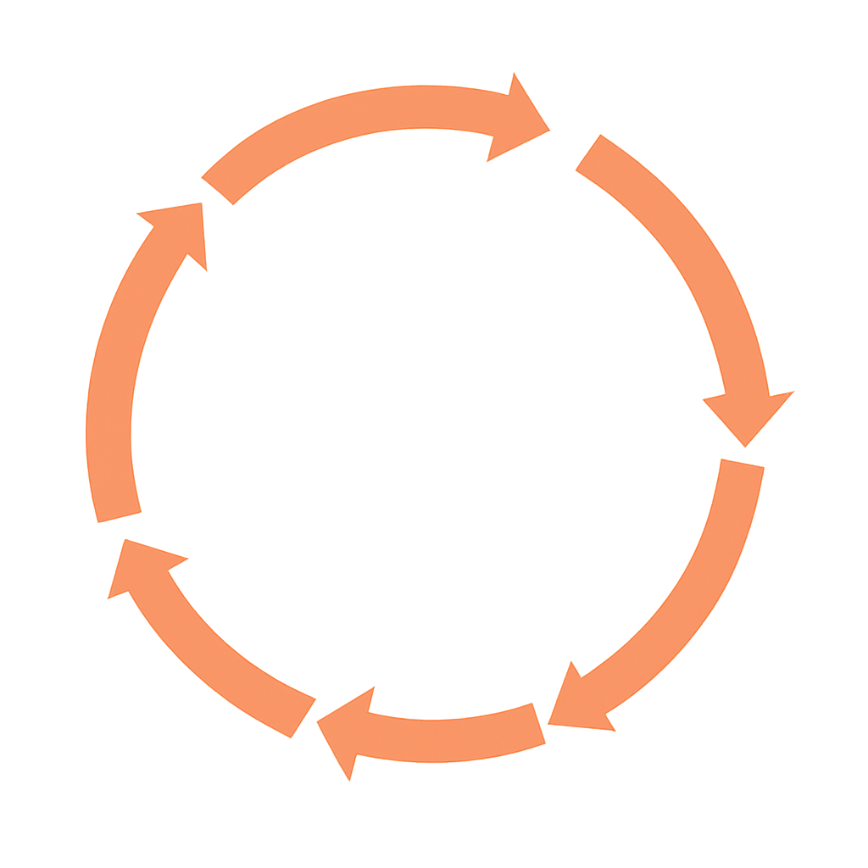


What is the Feedback Loop?
Collect Feedback
Reviews
Behavioural data
Detect & Analyse Issues
Identify patterns
Pain points
Close the Loop
Test re-engagement
Retention is Built on Listening, Learning & Looping back
Respond to Customer
Personal
Acknowledgement
Classify Customers
Recoverable?
Specific issues

Slide 3
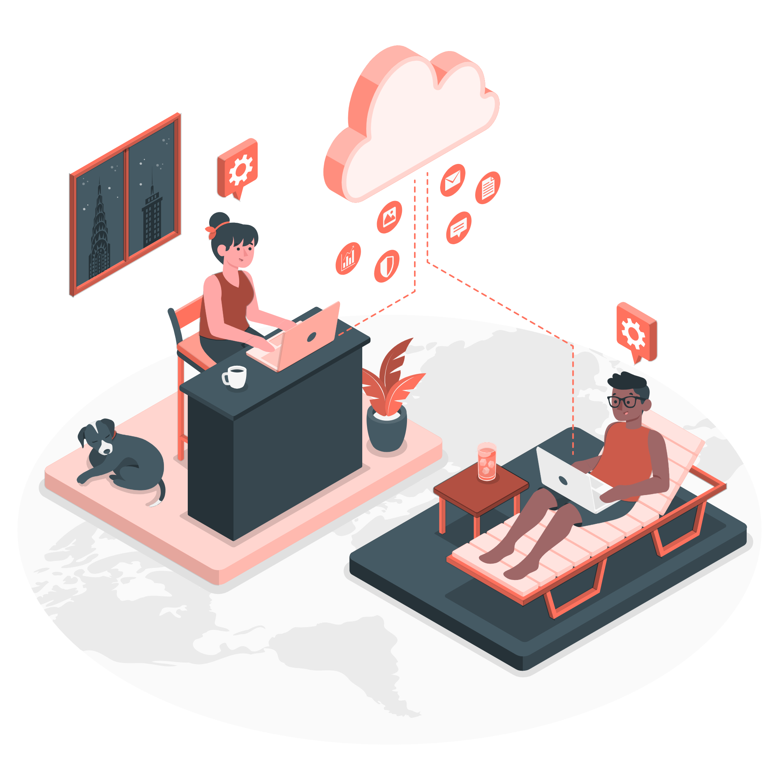
Value of the Loop
Companies with Feedback Loops make 2-3x more
76% Businesses admit not knowing how to build feedback loop
76% Customers feel brands ignore their feedback

Slide 4



Agenda
Objectives
EDA
Recommendations & Limitations

Slide 5
Tim – A Lost Customer
49% of Apps Uninstalled in first 30 Days
Tim - Left a Review - Cares
Uninstall
95% of Customers Willing to Give Companies a 2nd Chance

Slide 6

Rob & Jennie– Customer Service & Manager
89% App Reviews Unanswered
Cost of Acquiring New Customer 5-25x Retaining One

Slide 7

How do We Connect them?

Slide 8
Objectives
Problem
App Customer Churn Crisis
Stakeholders
Business & their Customers
Value Proposition
Provide Data Driven Solutions to Create & Automate Feedback Loop

Slide 9

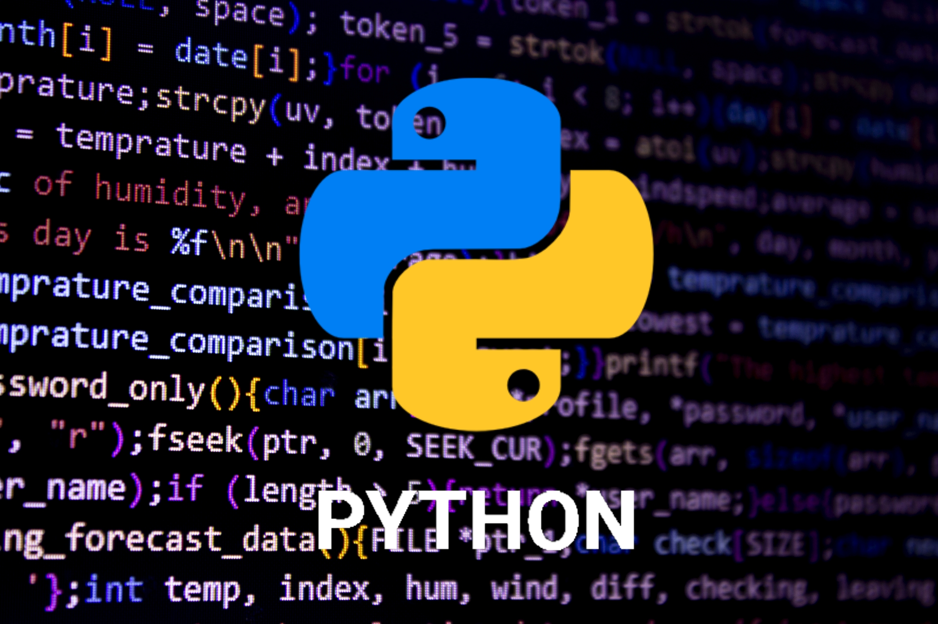




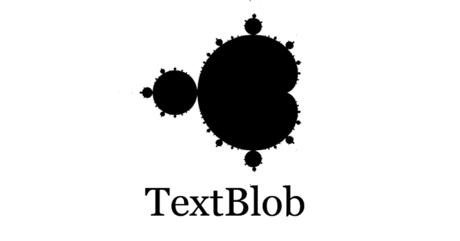


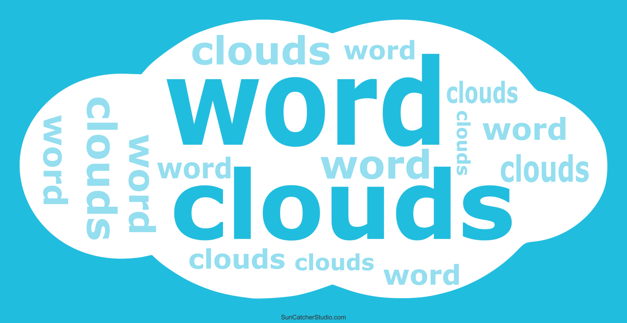



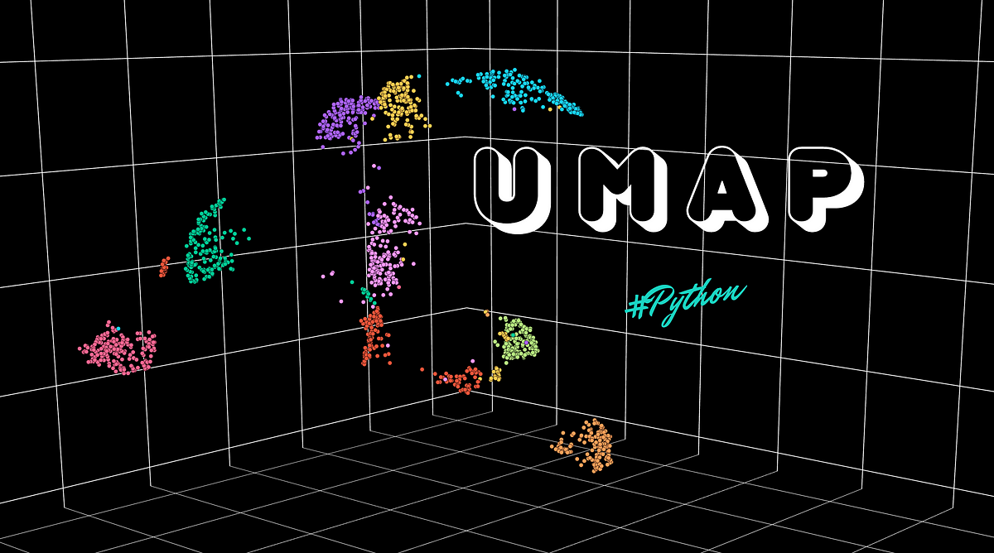





Data Process
Data & Text Cleaning
EDA
Reporting
Modelling & Automation

Slide 10

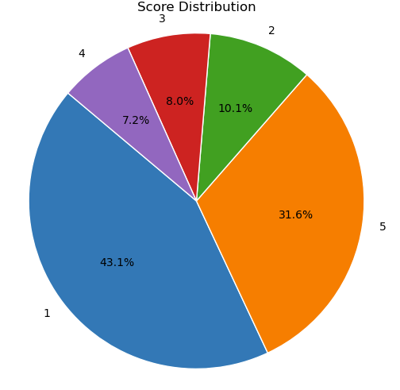


Data Exploration
Was great now I cant even get on the site. WhTs going on
Recoverable Customer

Slide 11
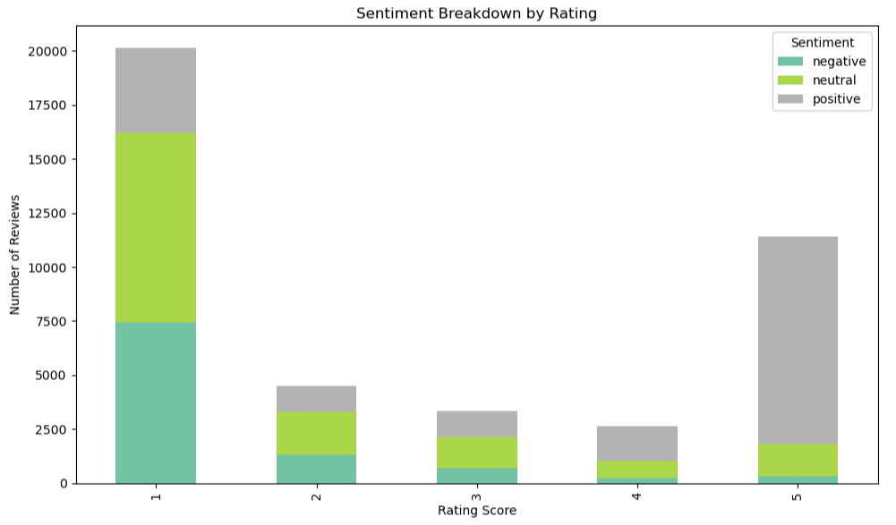

Language Sentiment Exploration
Are you Misreading your Customers?
Positive
Neutral
What They Say ≠ What They Click

Slide 12


Supervised Modelling – Detecting Dissatisfaction Teaching Models to Understand Customer Language
Engineered Features
– Tested for relevance, chosen by me
- E.g. Sentiment Polarity
+
BERT Embeddings
Deep Language Comprehension
Captures Tone, Structure & Subtlety
Combined for Robust Hybrid Model

Slide 13
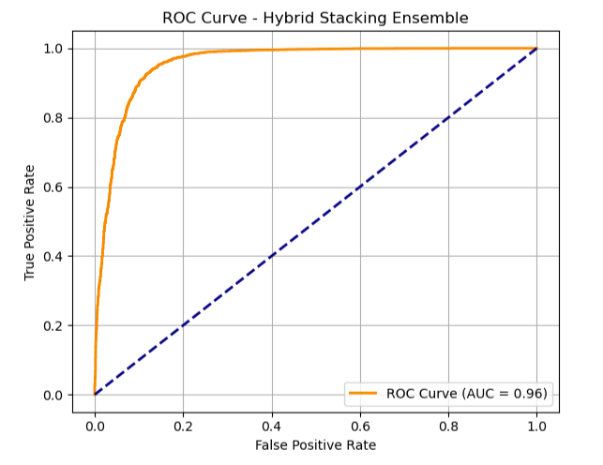
Model Performance - Amazon
ROC Curve
High ROC = Better Separation of Unhappy vs Happy Customers

Slide 14
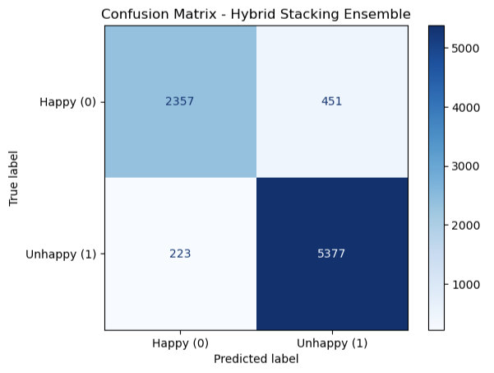


Confusion Matrix
Misfires
Correct Detection
Capturing 96% of Unhappy Customers

Slide 15

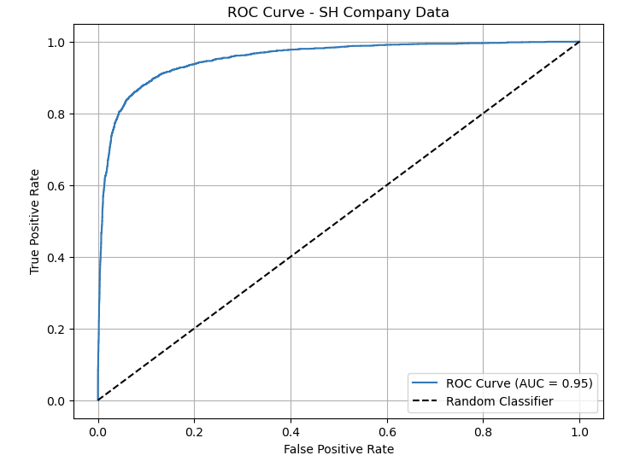
Real World Reliability
Test on New Company Data - Shein
High ROC Score – Generalising Well
✔ 86% of Unhappy Customers Captured
❌ No Re-Training Required

Slide 16

Understanding Unhappy Customers Unsupervised Learning
Maps Reviews into a 2D Space
Finds Clusters of Common Complaints
Labelling Complaints – Chaos to Clarity

Slide 17
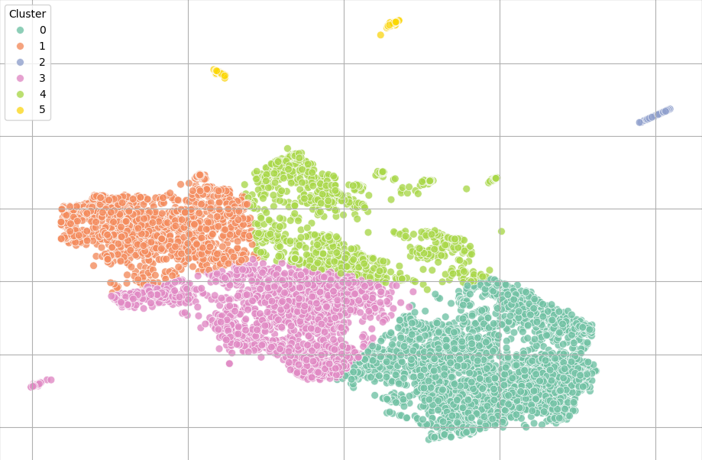

Complaint Topics - Clustering
Defining Actionable Insights
Customer Service + Delivery Issues
Buggy App Performance
AI Assistant Backlash
Past Order/Kindle Issues
Search Feature Frustration
Language Setting Issues

Slide 18

What’s Next?
Ability to Detect Dissatisfied Customers
Understand High-Level Customer Issues
Responding to & Acknowledging the Customers?
Automating the Process and Closing the Loop?

Slide 19
Closing & Automating the Loop
+
+
Kafka – Streams Reviews/Results into Dashboard
AWS – Scales Process on EC2 (Cloud Service)
CrewAI – Generates Automated Email Responses

Slide 20
From Detection to Response
📥 Reviews Streamed
Live reviews come through Kafka
🧠 Model Flags Unhappy
AWS-hosted model classifies each review
📂 Stored for CrewAI
Unhappy reviews are sent to CrewAI

Slide 21

Every unhappy review is handled by a specialised AI taskforce 🤖
Your AI Customer Recovery Team
They understand, evaluate, and respond just like real employees 🛠️

Slide 22
CrewAI In Action
🗣️ Customer Review:
"This is absolutely awful. I’m deleting this app today."
Tone Profiler | → Detected: Angry, frustrated, disappointed
Recoverability Evaluator | → Decision: No, no offers
Issue Matcher | → Category: General Dissatisfaction
Response Strategist | → Plan: Apologize sincerely, ask for brief details
Response Writer | → Email Drafted: Empathetic message, follow up

Slide 23
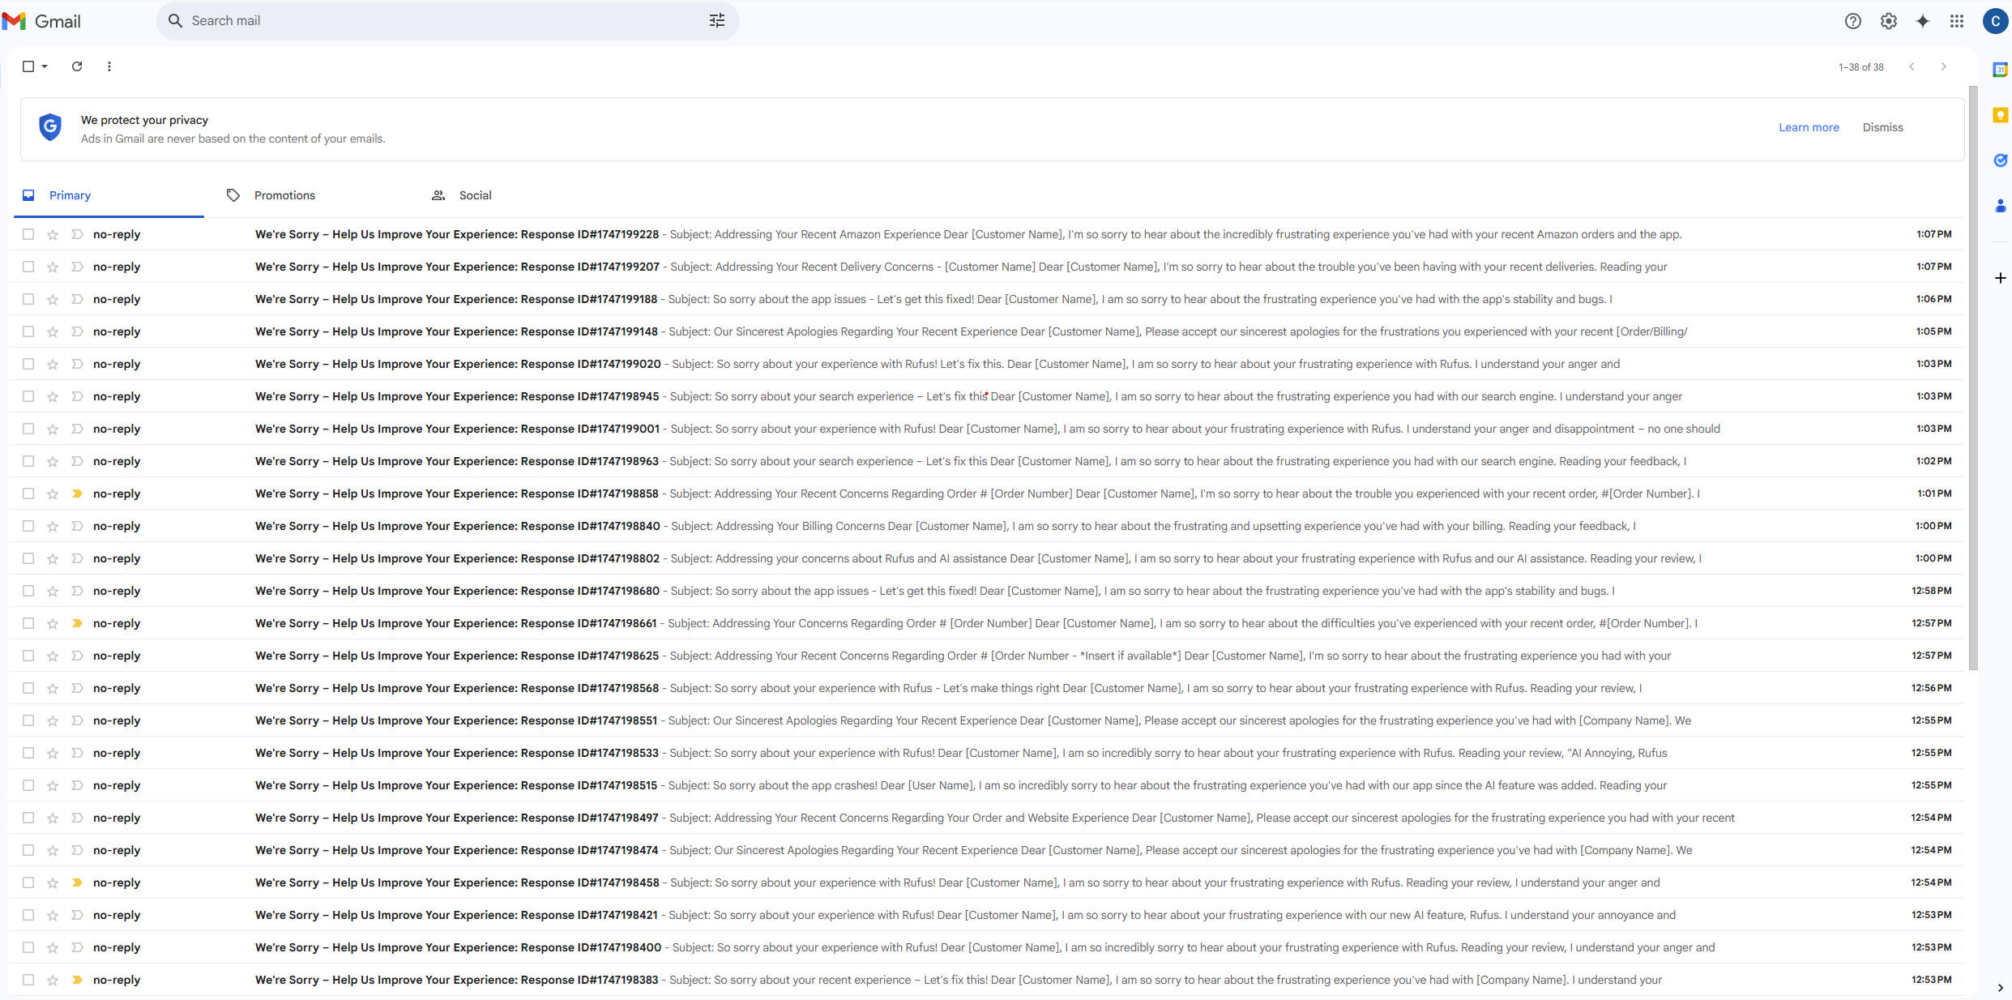
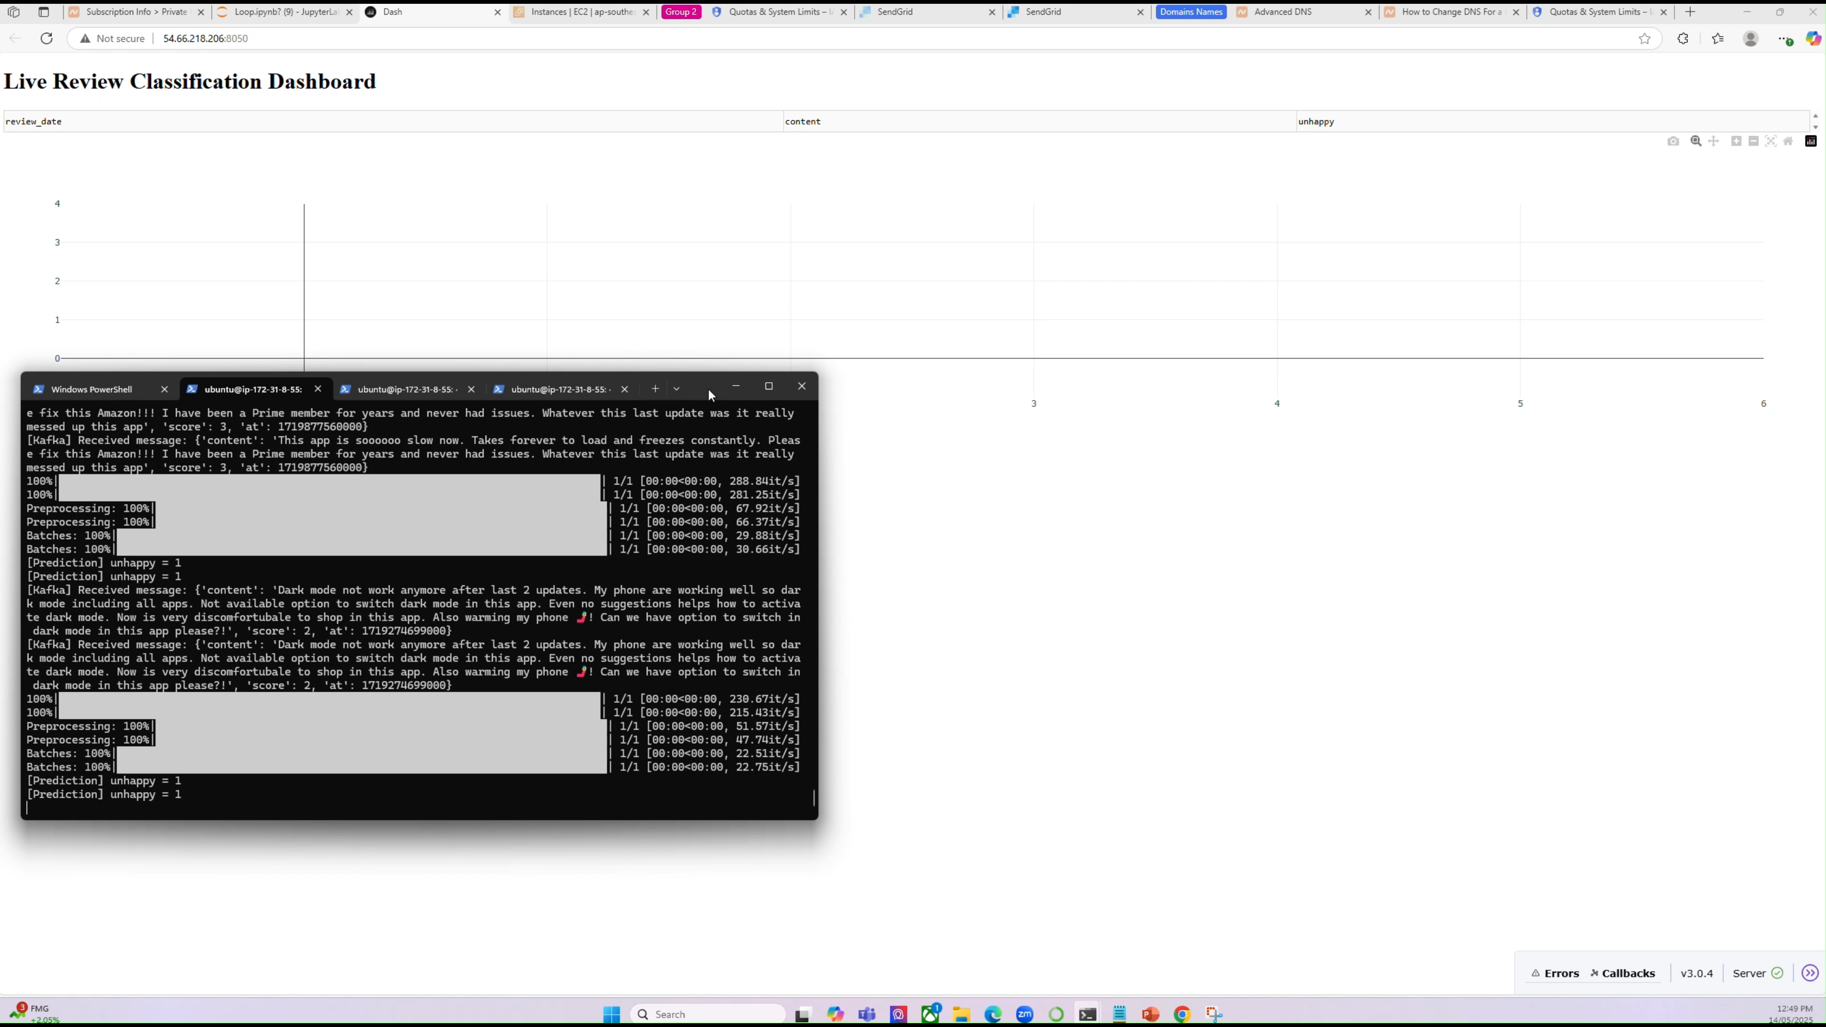
Live Automation Process

Slide 24

The Loop – Closed & Automated
Collect Feedback
Reviews
Behavioural data
Detect & Analyse Issues
Identify patterns
Pain points
Close the Loop
Test re-engagement
Retention is Built on Listening, Learning & Looping back
Respond to Customer
Personal
Acknowledgement
Classify Customers
Recoverable?
Specific issues

Slide 25

Business Recommendations
1. Deploy NLP Models – Automate Early Dissatisfaction in Customer Reviews
2. Apply Unsupervised Learning – Identify Hidden Complaint Patterns
3. Automate Recovery at Scale – Integrate Detection and Response Re-Engagement at Speed

Slide 26
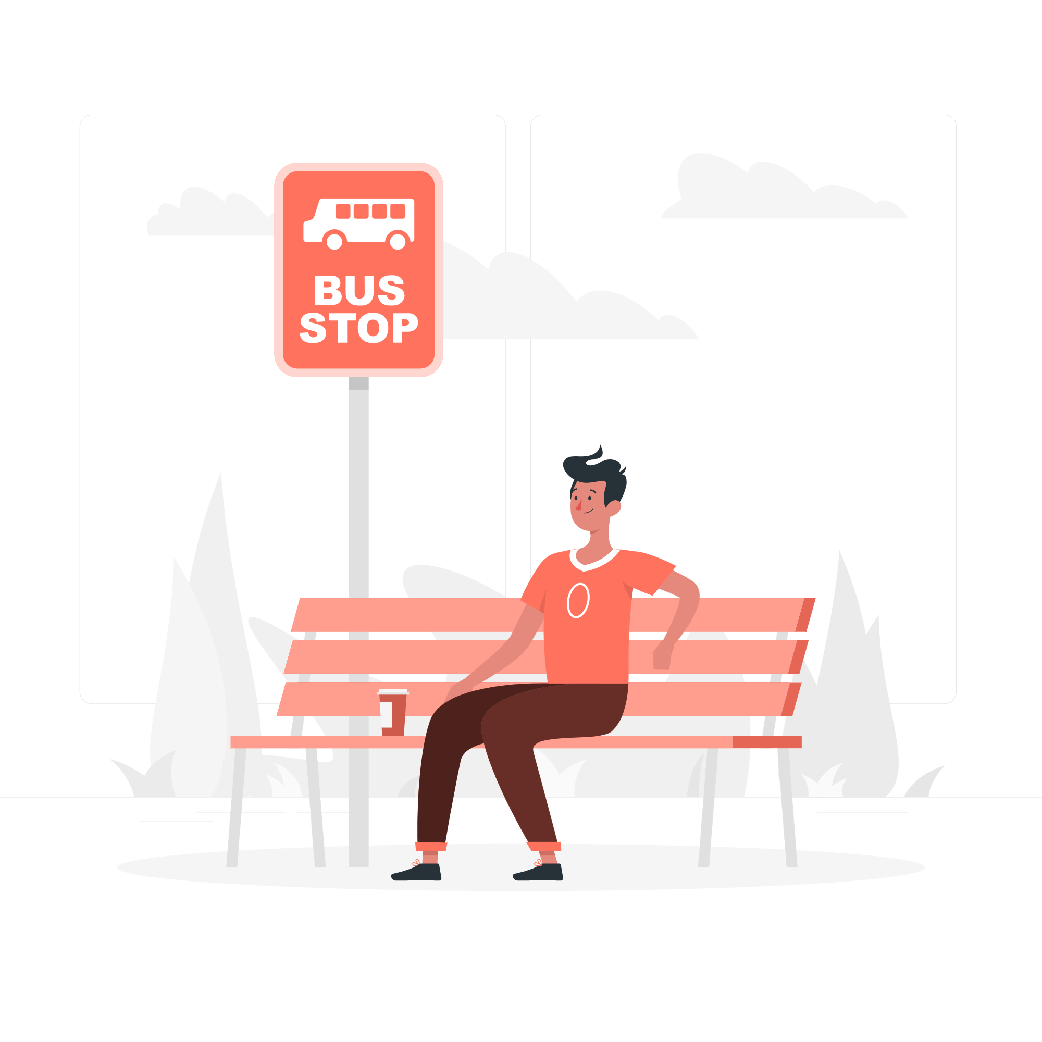

Limitations
1. Misclassification Risk
2. Some Customers can’t be Recovered
3. Scaling Costs
4. Live Monitoring and Follow Up Required

Slide 27
Stakeholders - Customer
Acknowledged & Valued by Brand – Keeps App
Re-Install
No more Uninstalling

Slide 28
Stakeholders - Business
89% App Reviews Unanswered
→ Answered
Access the 95% of Customers willing to give 2nd Chance
Customers 88% more likely to re-purchase
Positioned to make 2-3x More

Slide 29
Thanks
Great
Do you have any questions?
fordco14@gmail.com
(1) Connor Fordham | LinkedIn
Success

